Slide 1




BIG BULL
Co-ordinator
Mrs. Lee Juliet George
Internal Guide:
Dr. Lince Rachel Varghese
Submitted by,
Ajmal Johnson
MCA 4B
Roll no : 02

Slide 2

Front End :
HTML, CSS ,JS
Back End :
Python 3.9.8
DJANGO 3.0
Database :
SQLite 3.12. 2

Slide 3

Tools used :
IDE- Vs-code
Browser - Brave,Chrome

Slide 4

Packages Used :
Real Time Data Fetching: Y-finance
Data Visualization : Pyplot/Matplotlib
Algorithm Used:LSTM/FBPROPHET

Slide 5

Introduction

Slide 6

This project aims at building a web App that help the user’s to maximize their profit by their investment.
It will help the users to analyze individual stocks and make better decision.
By adding the stocks to their portfolio the user can analyze the stock individually and accurately.
It will help the users to better understanding of the stocks.
Brief introduction

Slide 7

Existing system
Shows real time data and visualization by Google finance and yahoo finance but not provided an approach to predict the stock market.
The stock market is volatile in nature so it is difficult to predict the stock market.

Slide 8

The main scope of the project is to simplify the difficulty in investment problem of the user’s. The main aim of the project is to maximize the profit by using the BIG BULL tool.
We use stock open price ,close price ,volume, market capitalization ,current price and which industry they belongs to these are the values that are considerd .
Proposed system

Slide 9

Stakeholders
Investors
Shareholders of the companies
individual investors
Angel investors
Institutional investors.

Slide 10

Modules

Slide 11

Modules
Login Page
User portfolio
Stock analysis
Adding stocks to portfolio

Slide 12

Use Case Diagram

Slide 13
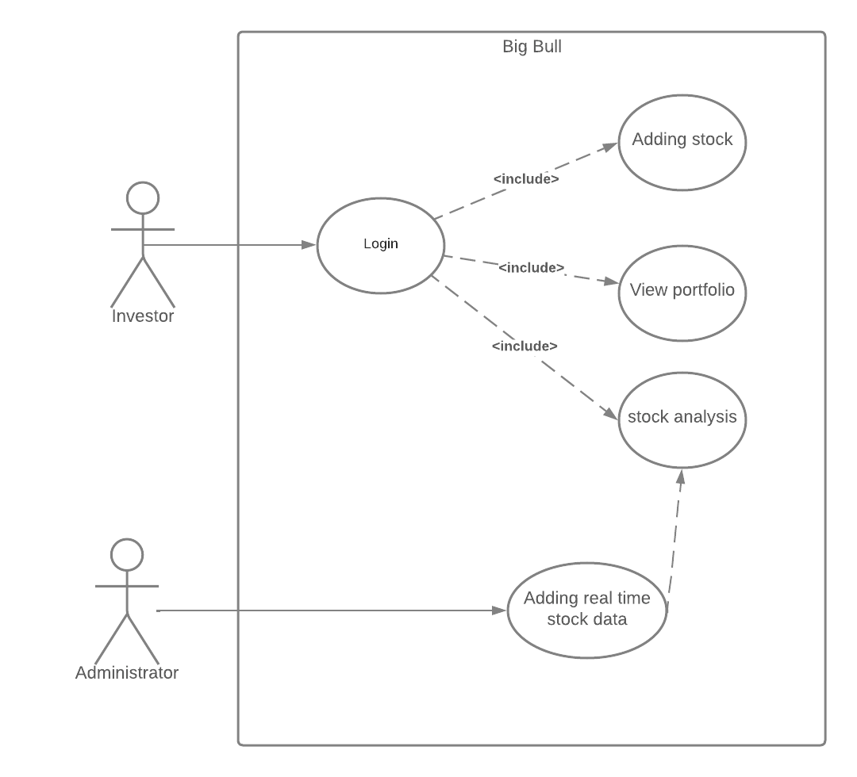

Slide 14

CONCLUSION

Slide 15

The goal of each stakeholders is to maximize the profit from their investment so that the system can help to generate profit from their investment.
BIG BULL is a useful tool for each of the stakeholders because they can make better decisions according to that.
The investment and recommendation of the stocks made by BIG BULL are for educational purpose only.
CONCLUSION

Slide 16

References

Slide 17

https://journals.plos.org/plosone/article?id=10.1371/journal.pone.0180944
https://www.google.co.in/books/edition/Advanced_Analytics_and_Learning_on _Tempo/oTMPEAAAQBAJ?hl=en&gbpv=1&dq=Compatible+deep+neural+ne twork+framework+with+financial+time+series+data&pg=PA61&printsec=front cover
https://arxiv.org/pdf/2206.06320.pdf
https://arxiv.org/ftp/arxiv/papers/2205/2205.05719.pdf

Slide 18


